Slide 1

Navigating Critical Conversations
Dr. Stephanie Delanie Vice President of Instruction, Renton Technical College
Zachary Florent Outreach & Education Coordinator, EEOC Seattle Field Office

Slide 2

Steps to Having Crucial Conversations
Dr. Stephanie Delaney

Slide 3
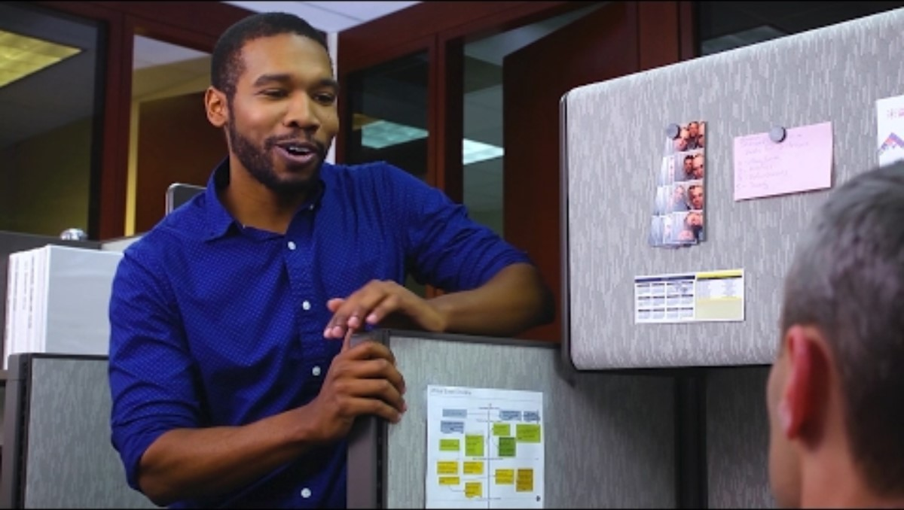

Slide 4


Slide 5


Slide 6


Slide 7
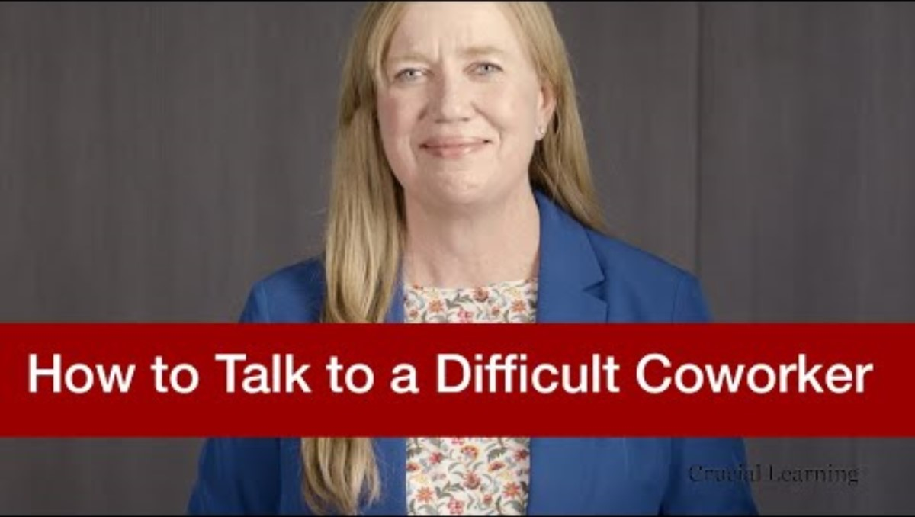

Slide 8
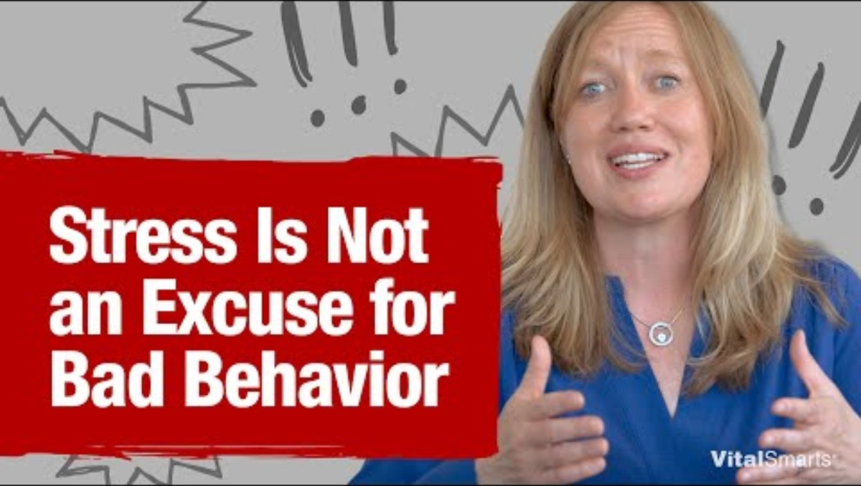

Slide 9


Slide 10


Slide 11


Slide 12

Protecting Yourself From Harassment & Discrimination

Slide 13

Part 1: Know Your Rights

Slide 14

www.eeoc.gov
The federal rights agency responsible for enforcing laws that prohibit employment discrimination.

Slide 15
What is discrimination?
To "discriminate" against someone means to treat that person differently, or less favorably, for some categorical reason.

Slide 16










Protected Groups
RACE
COLOR
NATIONAL ORIGIN
RELIGION
SEX
GENETIC INFORMATION
AGE
DISABILITY

Slide 17

Protected Activity:
Participation in the EEO Process
Retaliation Prohibited by All Statutes
It is unlawful to penalize, punish or deny an employment benefit because that person opposed discrimination or participated in any way in the investigation of a charge.

Slide 18

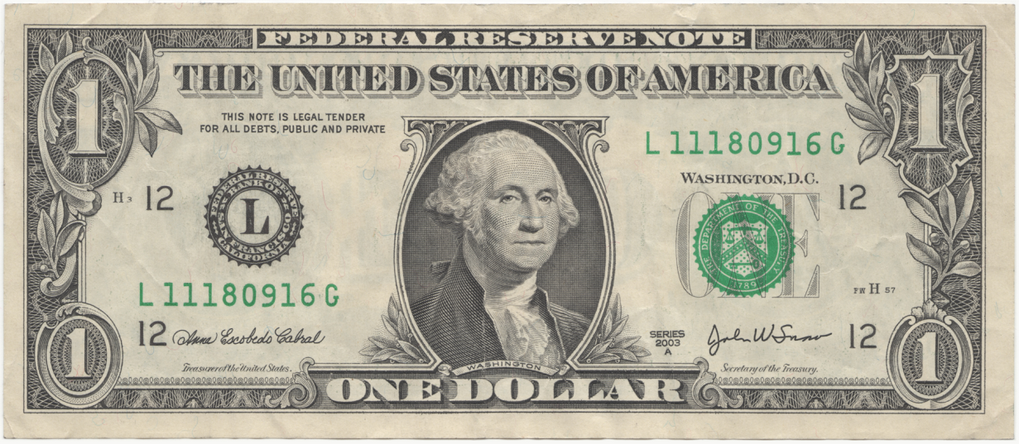

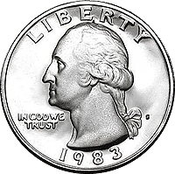


Laws Enforced by EEOC
Title VII of the Civil Rights Act of 1964, as amended
The Equal Pay Act of 1963, as amended
The Americans with Disabilities Act of 1990, as amended
The Age Discrimination in Employment Act of 1967, as amended
The Genetic Information Nondiscrimination Act of 2009
Pregnant Workers Fairness Act of 2023

Slide 19
What does every employee have the right to expect from their employer?
To be protected from harassment and discrimination
Ability to safely bring forward complaints of discrimination and harassment without fear of retaliation
Prompt and confidential investigation of complaints
Prompt, appropriate, and effective remedial action where an issue may have occurred

Slide 20
What are some examples of workplace discrimination?
Unfair treatment
  Hire/Fire
  Wages
  Promotion/Demotion
  Different Terms and Conditions: i.e. Job Assignments, Benefits, Leave, Training
Harassment
Failure to Provide Reasonable Accommodation
  (Disability, Pregnancy*, Religion)

Slide 21

Part 2: Have a Plan

Slide 22
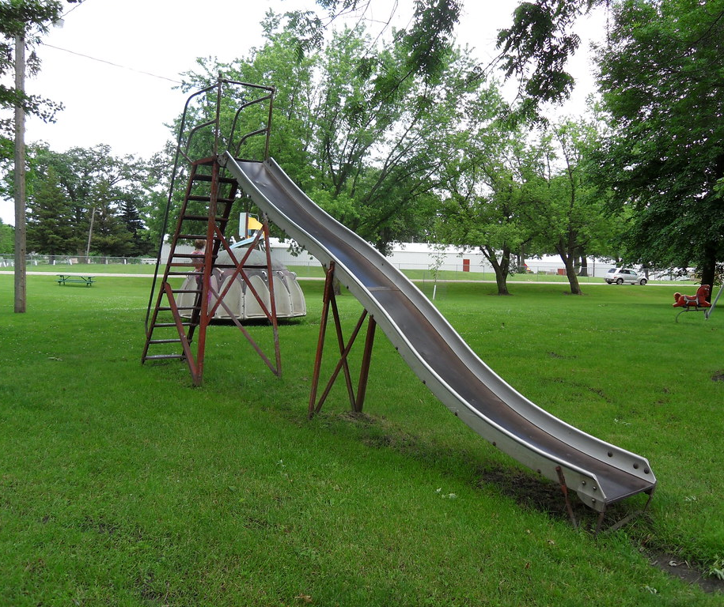
Addressing Incivility
Disrespectful, Rude, Uncivil, and Careless Behaviors
Abusive Behaviors
Harassment

Slide 23
Examples of Common Incivility
Sarcasm
Giving people unwanted nicknames
Eye rolling
Withholding information
Criticizing people publicly or allowing others to make negative comments
Not giving “face” during discussions and meetings
Interrupting or denying floor time
Ignoring
Baiting
Being intentionally unavailable
“Forgetting” to include

Slide 24
Parameters and Clarifications
Rude and uncivil behavior can affect the work culture, environment and experience
These actions may not be unlawful or actionable BUT;
  A culture that allows uncivil behavior can lead to dissatisfaction, conflict, and, ultimately, powerful inequities.
Oftentimes, these behaviors are a byproduct of our “autopilot” being in control – failing to be mindful of how the things we do or say impact those around us.
We all have our blind spots. Most people would like to hear about them from our friends and co-workers rather than from HR or a supervisor….

Slide 25

Feedback: The Unwanted Gift
Thank
Show appreciation
Admire the gift
Tell them you will do something with it
Thank you!
I appreciate it!
I know exactly what I’ll do with it!
Avoid
Striking back
Counter-grievance
Impugning them
Minimizing their concern or suggesting they misunderstood

Slide 26

Giving the Gift
Begin with a positive intention
Be specific about behavior
Be specific about impact
Focused on a desire to have the behavior stop/change

Slide 27
Addressing Harassment and Discrimination
Disrespectful, Rude, Uncivil Behaviors
Abusive Behaviors
Harassment

Slide 28
Harassment is…
Repeated targeted mistreatment of one or more people, by one or more people.
May be Verbal, visual or physical
May be psychological (e.g. gaslighting)
Sexual harassment may be sexual advances, requests for sexual favors, and other verbal, visual or physical sexual conduct

Slide 29
Examples of Harassment
Sexual harassment
Abuse for being female or non-binary (sex-based, not necessarily sexual)
Repeatedly and intentionally misgendering someone (e.g. wrong pronouns, dead-naming)
Offensive photos, drawing, or images based on sex, religion, race, national origin, etc. (e.g. Swastika graffiti)
Offensive Comments or racial/ethnic slurs
Mocking disability, age or religion

Slide 30
“Hostile Work Environment”
Disparate Treatment
Sexual advances by supervisor with adverse impact
For example, an employee is denied a promotion because they rejected the sexual advances of their supervisor
Also known as quid pro quo harassment
Hostile Work Environment
Unwanted conduct either so severe or pervasive it unreasonably interferes with a person's work or creates an intimidating, hostile or offensive work environment.

Slide 31
Hostile Work Environment
Unwelcome
Severe or Pervasive
Offensive

Slide 32
What’s the employer’s obligation?
To provide a workplace free from harassment and discrimination
Meaning… the employer must safeguard against harassing conduct from:
  Supervisors/Managers/Executives
  Co-workers
  Third-parties (Customers/clients, delivery people, contractors/temp staff, etc)

Slide 33
I think I was discriminated against at work. What do I do now?

Slide 34
Tell Your Employer
Talk to your supervisor or other representative
Be serious, honest and direct
Make it clear that you want the discrimination and/or harassment to stop
Take advantage of the company’s internal complaint process
Put your complaint in writing – be specific
Follow up
Remember: Retaliation is Prohibited

Slide 35
Protected Forms of Opposition
Threatening to file or assist in filing a charge, complaint, grievance and/or lawsuit alleging discrimination
Complaining about discrimination to management, union, employees and/or newspapers
Organizing or participating in a group which opposes unlawful employment discrimination
Refusing to obey an order because of a belief that it constitutes unlawful employment discrimination

Slide 36

Contact EEOC
If you have not been able to resolve your situation with your employer, you may want to contact EEOC.
EEOC charges no fees for its services.

Slide 37
Filing a Charge of Discrimination
When an employee or applicant believes they have been discriminated against in the workplace due their membership in a protected group, they may file a Charge of Discrimination with EEOC.
Charges are statements of allegations, a summary of the harm the employee believes they have been subjected to by their employer.
EEOC takes these Charges, serves them on the employers, and in some cases investigates, attempts to settle, or litigates.
Fundamentally, any employee has the right to file a Charge and the right to file a lawsuit based on that Charge.

Slide 38
INTAKE
Mostly virtual
Contact us by mail, internet or phone call.
  1-800-669-4000
  https://publicportal.eeoc.gov
  909 1st Ave Suite 400, Seattle, WA 98104
An EEOC intake officer may need to contact Charging Party to get additional information.
Notice is served on employer within ten days of receiving a Charge document

Slide 39
Intake Interview
EEOC Investigator interviews “potential charging party” (PCP)
  Does EEOC have jurisdiction?
  What kind of discrimination?
  Any comparators? Witnesses? Other evidence?
Counsels PCP
  Provide honest, professional assessment
  Explain EEOC’s investigative process
  Determine interest in mediation

Slide 40
Our Jurisdiction
Employers Covered
Who can file a Charge?
Private Employers
Educational Institutions
Labor Organizations
Joint Labor-Management Apprenticeship and Training Committees (Title VII & ADA)
Employment Agencies Serving Covered Employers
State and Local Governments
An employee
A temporary employee
A job applicant
A former employee
Undocumented workers

Slide 41
Other Jurisdictional Requirements
Employer-Employee Relationship
Minimum Number of Employees Company-wide:
  15 employees
  Age cases = 20 employee
  Equal pay allegations based on sex only = 1 employee
Timeliness
  Charges against employers in Washington must be filed with EEOC within 300 days from the last date of alleged violation.
  In some jurisdictions, time frame may be 180 days.
  EPA: 2-3 years to file in court, deadline not impacted by charge

Slide 42
Immigration Status
Everyone is protected, regardless of status. Congress and Courts have made this clear.
EEOC never asks about immigration status during charge filing or investigation, nor is it relevant in determining merits of a charge.
For victims of certain crimes, attempted crimes or threats, EEOC may be able to assist with obtaining a U-Visa.

Slide 43
How to Contact the EEOC
Toll Free: 1-800-669-4000
E-mail: info@eeoc.gov
To submit an inquiry and begin the charging filing process
https://publicportal.eeoc.gov/ (English)
https://www.eeoc.gov/es/initial-consultation (Español)

Slide 44


CHARGE PROCESS
Mediation
Settlement or Withdrawal
Conciliation
Successful
Charge Filed
Investigation
Cause Finding
Conciliation
Conciliation Failure
No Cause
Right to Sue Requested
Right to Sue Issued
EEOC Sues

Slide 45
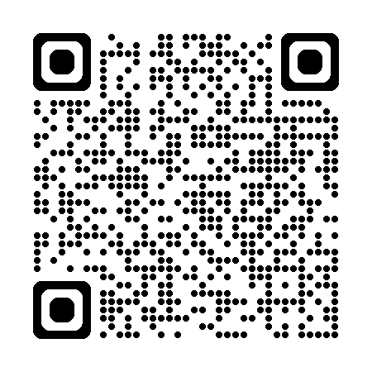
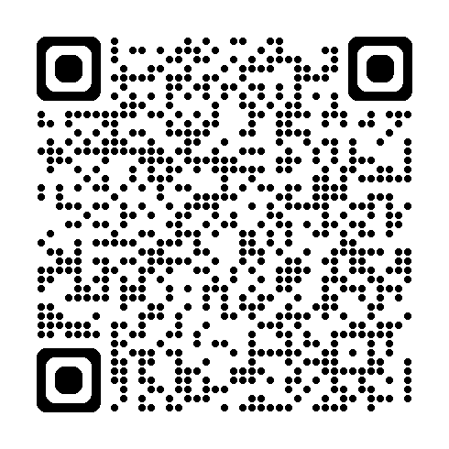
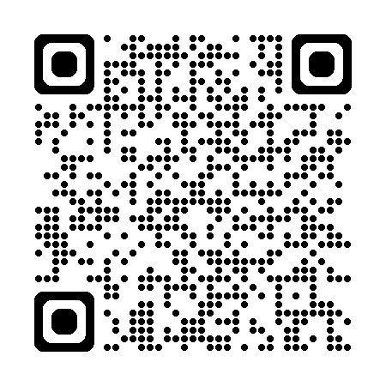
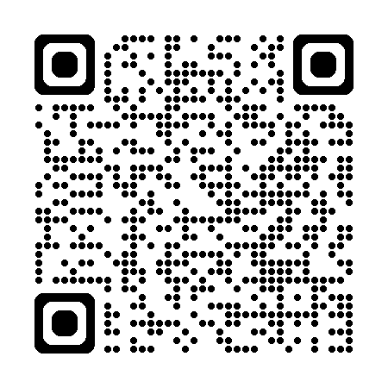
Additional resources
Promising Practices For Preventing Harassment In The Construction Industry
Building for the Future: Advancing Equal Employment Opportunity In the Construction Industry
Combating Employment Discrimination in Construction
Enforcement Guidance on Harassment in the Workplace

Slide 46



Thank you!
Please contact me if you have questions regarding EEOC, our processes, or the laws we enforce.
Zachary Florent
Outreach & Education Coordinator
zachary.florent@eeoc.gov
206.576.3001

