Slide 1

The Respectful Workplace Initiative:
Solutions for workforce diversity and retention in Oregon’s construction industry
ANEW Inclusion Summit
November 21, 2024 | Renton, Washington

Slide 2



Presentation Overview
Erin Flynn, Ph.D., Outreach Program Director
Respectful Workplace Initiative Overview
Respectful Workplace Resource Hub
Emily Huang, Ph.D., Professor and Director, OHSU Climate Safety Lab
OHSU Safety Lab
Respectful Workplace Climate Scale
Tradeswomen Project

Slide 3



Partnership
All partners support the shared goal of recruiting and retaining a diverse construction workforce to address the industry's labor shortage and create career pathways for historically marginalized groups.

Slide 4

Purpose
The Respectful Workplace Initiative aims to equip the construction industry with new evidence-based tools and resources to build a respectful workplace culture that will retain a diverse workforce.

Slide 5
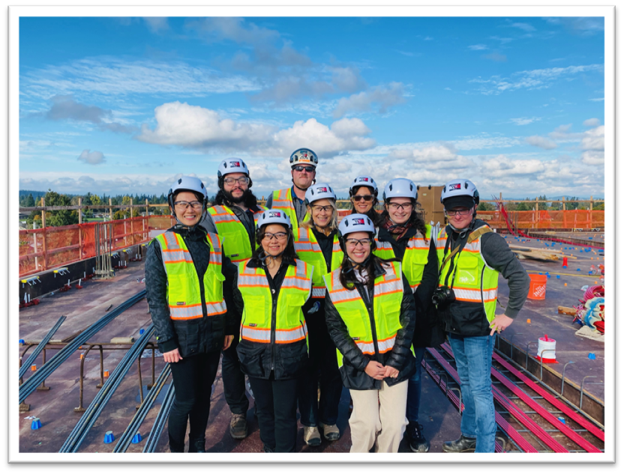
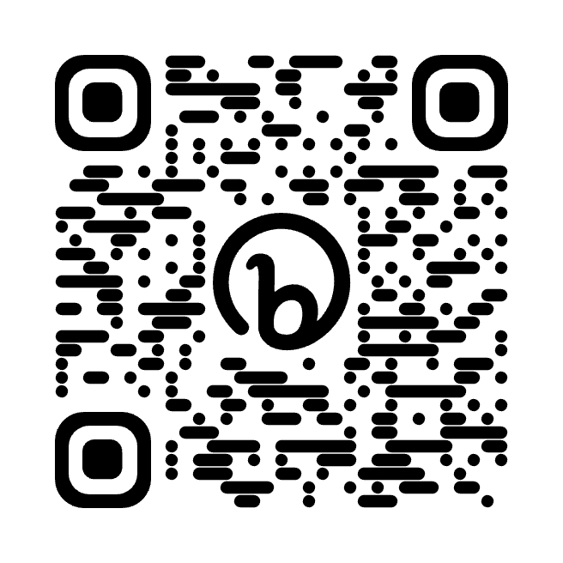
Oregon Institute of Occupational Health Sciences
We conduct research and develop evidence-based tools, training, and educational programming to improve the safety, health, and well-being of workers in Oregon and beyond.
Our mission is to promote well-being and prevent disease and disability among working Oregonians.
Visit our website:

Slide 6
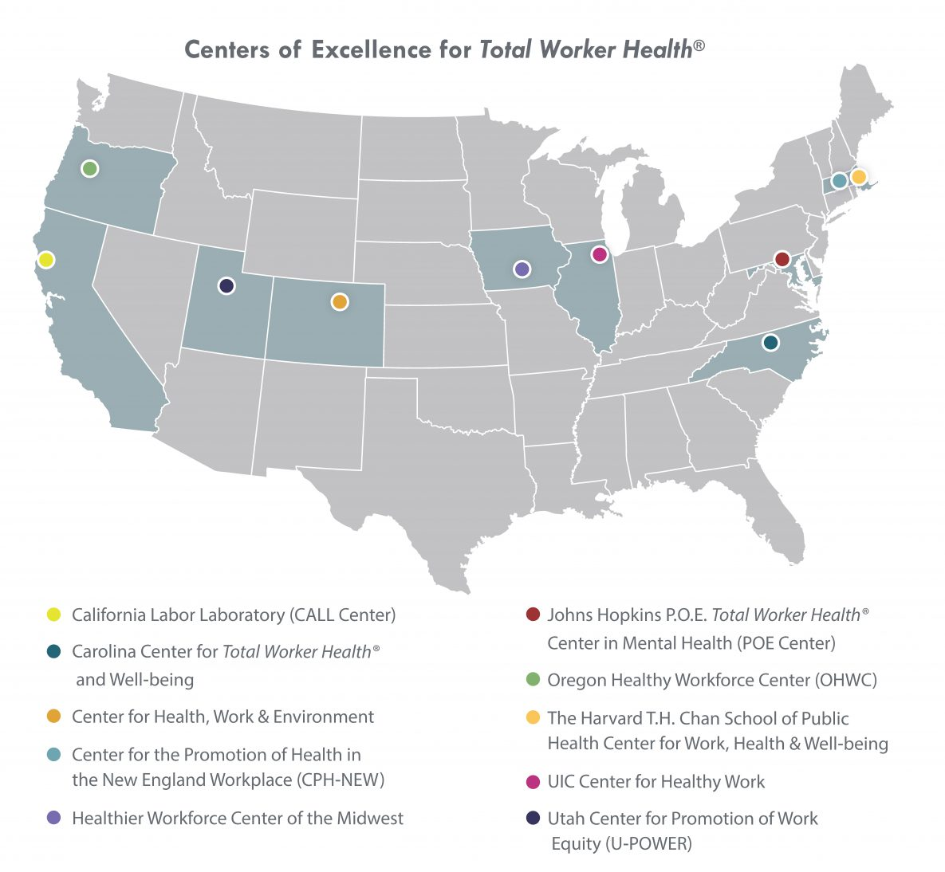
A NIOSH Center of Excellence for
Total Worker Health®
What is Total Worker Health®?
Total Worker Health seeks to enhance worker well-being by informing the design of work and employment conditions in ways that prioritize both the physical and psychological safety of workers.

Slide 7

What Challenge is RWI addressing?
The construction industry has recently received a huge injection of federal funding. The industry needs to attract and retain diverse workers to meet demand.
Construction job sites are often characterized by incivility including harassment, discrimination, and bullying making it challenging to recruit and retain women and people of color to the industry.
While some construction companies have initiated culture improvement efforts, change is slow and uneven; there is a gap in assessing progress and providing evidence-based support.​

Slide 8
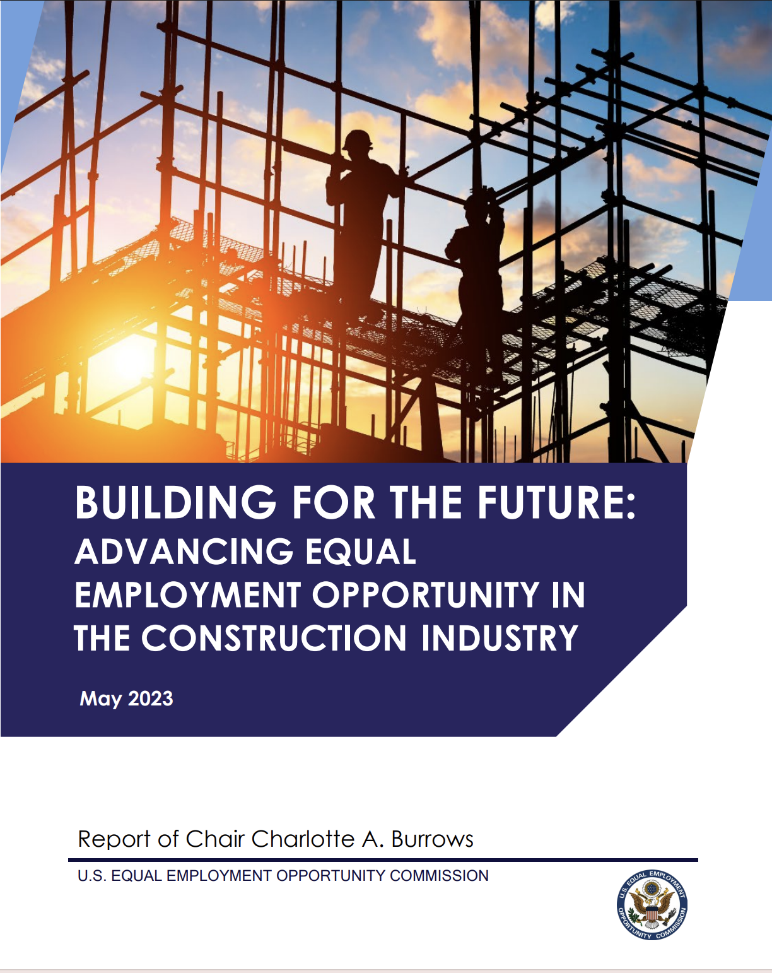
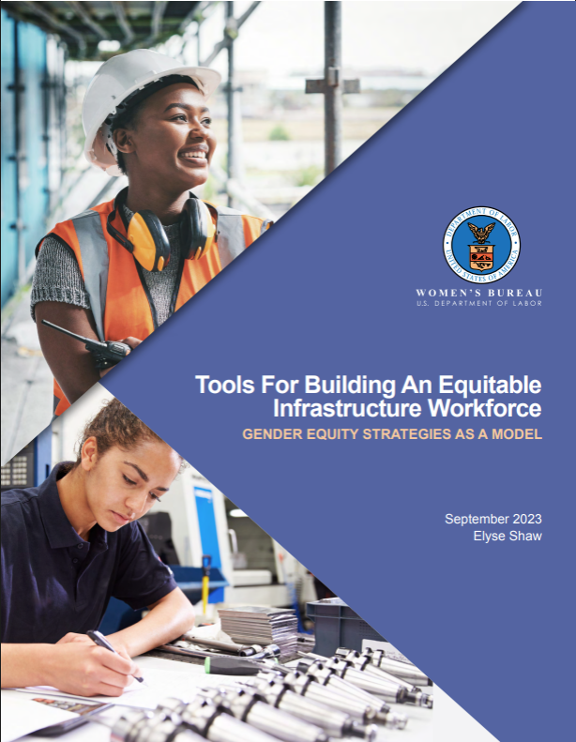
Federal Context
Recent Developments
Bipartisan Infrastructure Law
CHIPS
Million Women in Construction
U.S. EEOC Reports
Women’s Bureau Toolkit

Slide 9
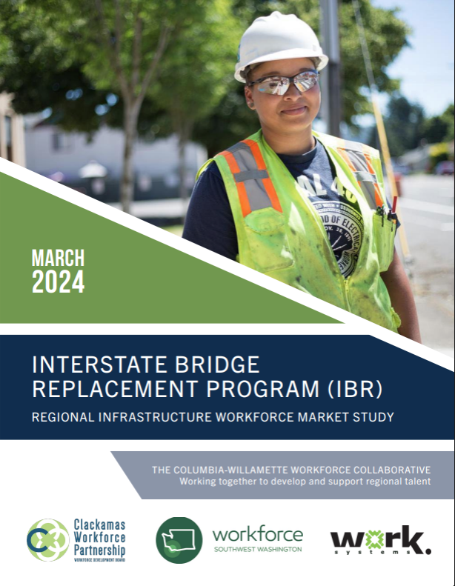
“Harassment remains a significant issue on job sites. This includes harassment based on gender, race, and other identities. The industry has not yet widely adopted policies and practices that effectively address jobsite harassment and discrimination incidents.”
Oregon Context
Regional Workforce Equity Agreement (Portland metro)
Safe from Hate Alliance and Worksite Culture Pledge
Public contracting law – HB 2649
Respectful Workplace policy – SB 851

Slide 10
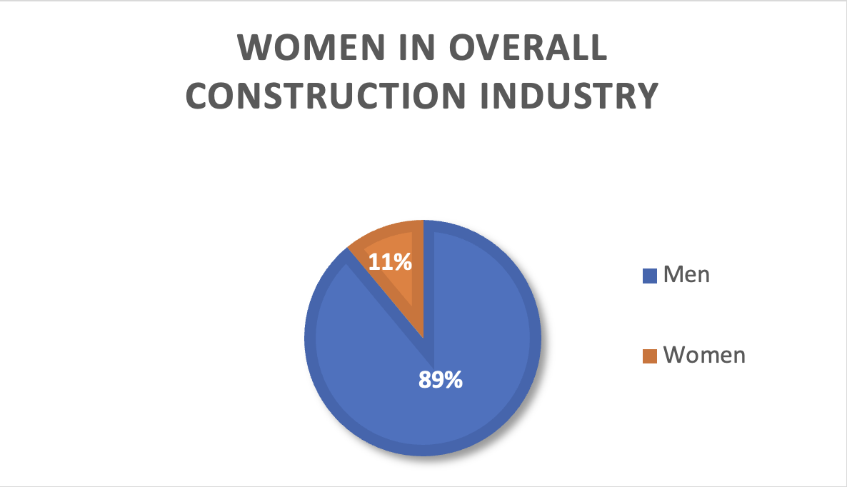
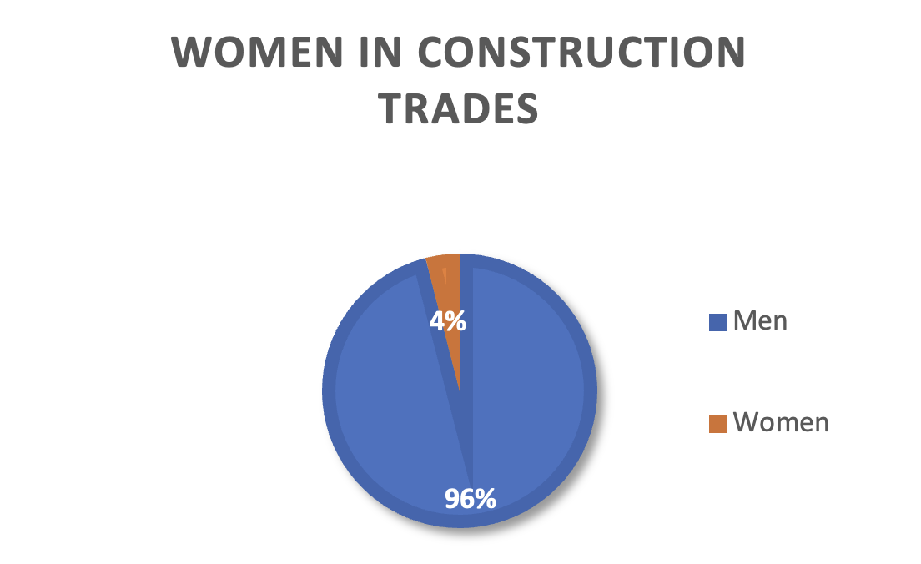
Women in Construction
U.S. Bureau of Labor Statistics 2021 data (NCCER, 2022)

Slide 11

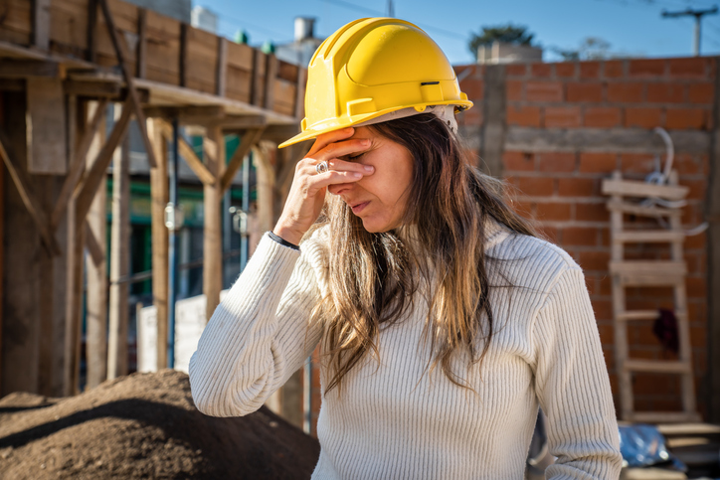

Harassment and Discrimination
26.5%
Report frequent or constant harassment for being women.
21%
Of women of color report frequent or constant racial harassment.
23.6%
Report frequent or constant sexual harassment.
2021 IWPR Tradeswomen’s Retention and Advancement Survey data
(Hegewisch & Mefferd, 2021)

Slide 12
Apprenticeship Retention
The completion rate for apprentices who started a highway trades apprenticeship in 2014-2015 is 49%.
White men complete apprenticeships at a higher rate than all other groups; Black men complete apprenticeships at the lowest rate of all groups.
2022 Needs Assessment for Oregon’s Highway Trades Apprenticeship (Kelly & Benitez, 2022)

Slide 13
Apprenticeship Retention
Mistreatment from employer
Felt Disrespected
One of the most common reasons for leaving an apprenticeship was problematic jobsite culture.
Lack of diversity
2022 Needs Assessment for Oregon’s Highway Trades Apprenticeship (Kelly & Benitez, 2022)
Harassment

Slide 14
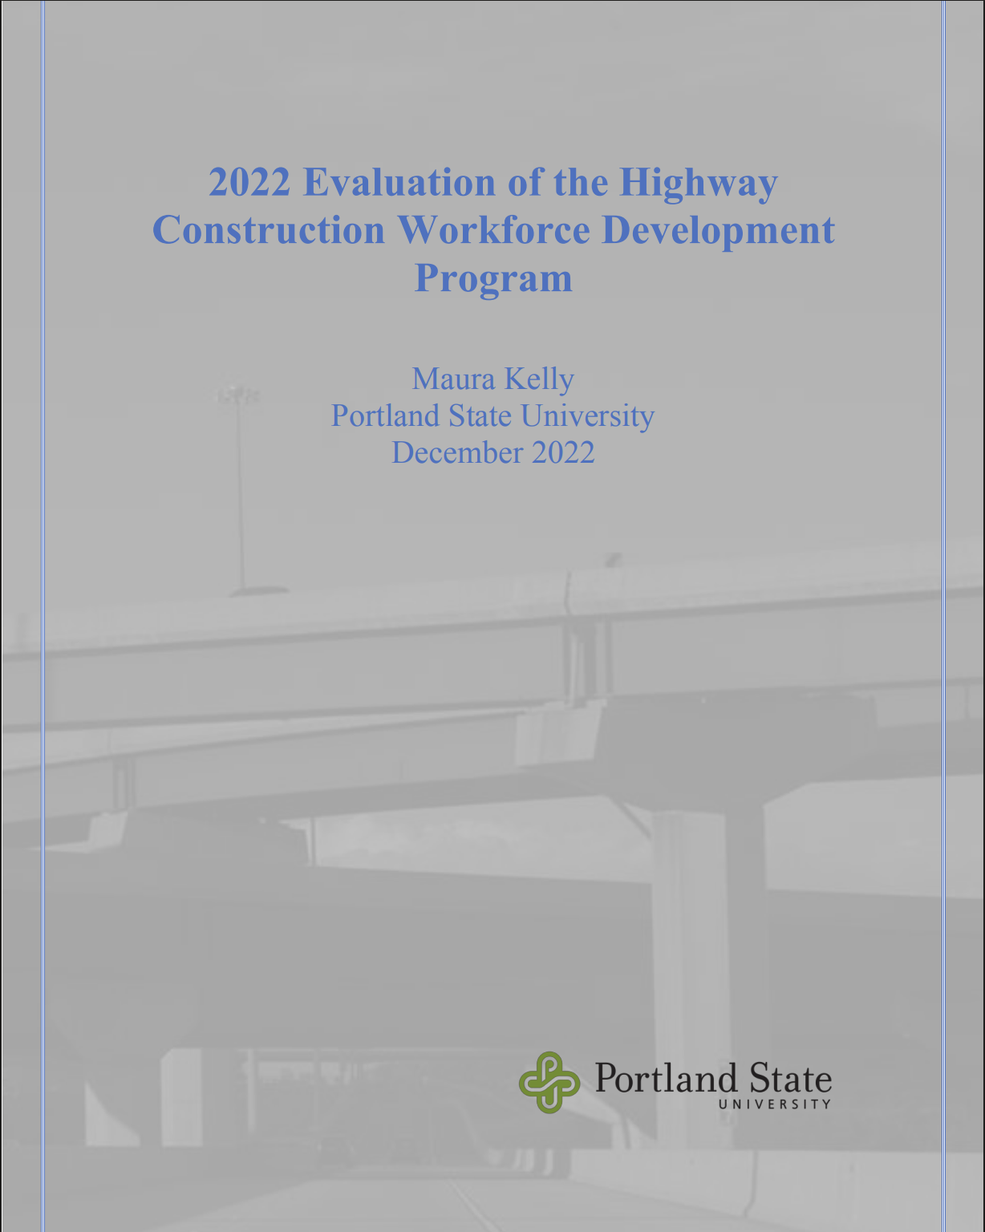



Growing consensus: retention is linked to jobsite culture

Slide 15

What is a Respectful Workplace?
A respectful workplace is one in which all employees feel safe, valued, and treated with respect.

Slide 16

What are the dimensions of
a respectful workplace?
free of harassment
free of discrimination
characterized by civility
demonstrable commitment to DEI
demonstrable commitment to organizational justice

Slide 17
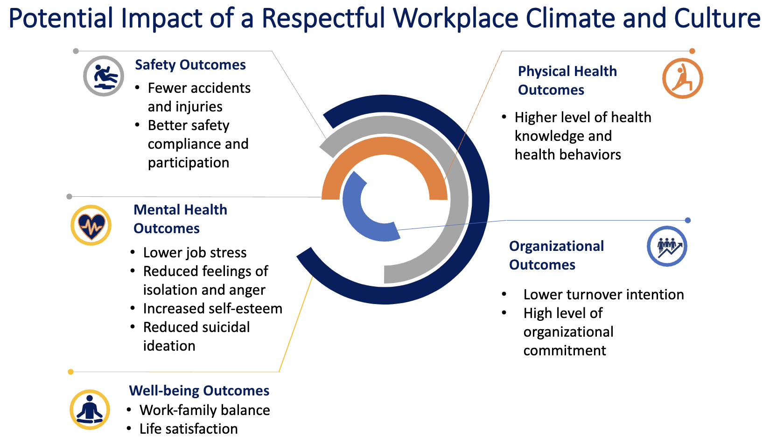

Slide 18


Respectful Workplace Initiative:
Two Key Components
Respectful Workplace
Climate Scale
+
Respectful Workplace
Resource Hub

Slide 19
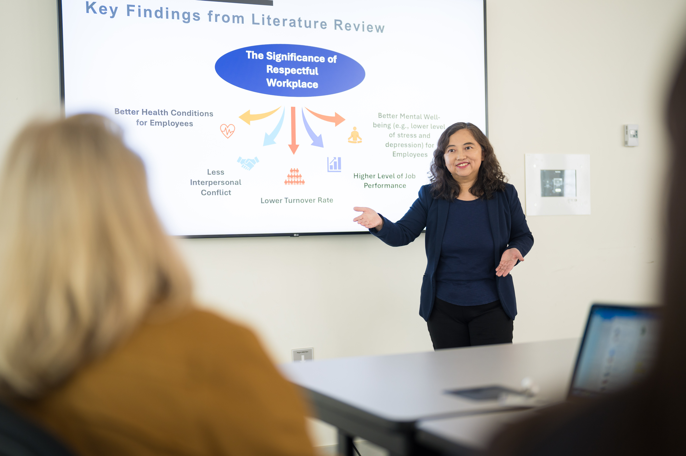
Respectful Workplace Climate Scale
The RWC Scale was developed by Dr. Emily Huang at the Safety Climate Lab at OHSU and draws on over 40 years of research in the safety climate arena. The Scale is validated and ready for implementation.

Slide 20
Respectful Workplace Resource Hub
The Resource Hub is in development. It will be an on-line repository of evidence-based and evidence informed:
Trainings
Tools
Policies
Informational Resources
Notes:
(50+

Slide 21
Building the Respectful Workplace Resource Hub
Scientific Literature Review
Stakeholder Interviews
Training Review
Grey Literature Review
40+ interviews with public owners, general contractors, subcontractors, unions and subject matter experts
50 + interviews with public owners, general contractors, subcontractors, unions and subject matter experts
25+ trainings from private companies, universities, unions, government departments, and nonprofits
20+ peer reviewed articles evaluating respectful workplace related interventions
20+ peer reviewed articles evaluating respectful workplace related interventions
25+ trainings from private companies, universities, unions, government departments, and nonprofits
50+ resources including guides, tool kits, sample policies, assessments, factsheets, etc.
20+ key reports and articles
Notes:
Erin

Slide 22

Scientific Literature Review
THEME 1:
Content & Curriculum
Foundation of Civility
Supportive Leadership
Emphasis on Diversity
THEME 2:
Design & Delivery
Training Needs Assessment
Participant Centered and Adaptable
Engaging Skill Building Activities
Repeated Engagement
Resource Hub informed by:
Scientific Lit Review on Workplace Interventions
Grey Lit Review on Construction Industry & Culture
Extensive search and review of available construction industry trainings, tools, and resources
Interviews with general contractors, public owners, & unions (50+)
THEME 3:
Organizational
Integration
Comprehensive Organizational Approach
Visible Leadership Commitment
Participation Across All Employee Levels
Alignment with Organizational Policies
Notes:
(50+

Slide 23
Stakeholder Interviews: Summary Findings
Variation characterizes all parties; the result is a panoply of policies, practices and training programs from contractor-to-contractor and jobsite-to-jobsite. ​
Current idiosyncratic environment reflects the nascent state of the field; most stakeholders are uncertain how to facilitate/advance respectful workplaces in a consistent way.
​All parties are interested in and would benefit from greater standardization of policies, practices, and education and training programs.
The need is real; lots of activity in play
Considerable variation across the industry
Lack of consistency in content and delivery

Slide 24

Summary of Findings:
Public Owner Expectations and Requirements
Respectful workplace practices and programs are far less developed than DEI programs
Public owners actively require respectful workplace practices of GCs; they typically don’t specify the how or what, leaving it to GCs to develop or contract for programming
Public owners hold GCs accountable for jobsite culture and subcontractor behavior
Few public owners systematically track or measure changes or improvements in jobsite culture
Who pays for respectful workplace programming is often unclear

Slide 25

Summary of Findings:
Contractor Culture and Practice
Many large GC and subcontractors have established internal respectful workplace policies, practices, and trainings
Fluid nature of jobsites makes consistency and accountability for respectful workplace practices extremely challenging
Foremen are instrumental in establishing jobsite culture; training foremen in interpersonal communication, conflict resolution, and emotional intelligence emerged as a key priority
Emerging view that respectful workplace practices and expectations should be incorporated as part of safety – i.e. integrate physical and psychological as opposed to HR or DEI

Slide 26
Resource Hub Timeline
Research + Stakeholder Outreach & Engagement
Resource Hub Design &
Development
Resource Hub Soft Launch (test and refine)
Resource Hub Launch and Scale
2024
2025
2026
2027

Slide 27
Connecting the Dots
Organizational Assessment
RWI is an opportunity to raise the bar on how employers can successfully build a culture of respect aligned with a Total Worker Health approach for the construction industry.
Standardization of evidence-based respectful workplace practices in construction is a challenging process; changing culture is hard work and takes time.
Oregon and Washington are in a good position to lead this effort!
Respectful Workplace
Total Worker Health
Leadership
Buy-in
Skills Training
Employee
Engagement
Supportive
Supervision
Physical Safety
Mental Health
Psychological Safety
Diversity & Inclusion

Slide 28
The Respectful Workplace Initiative:
Solutions for workforce diversity and retention in Oregon’s construction industry
ANEW Inclusion Summit
November 21, 2024 | Renton, Washington

Slide 29
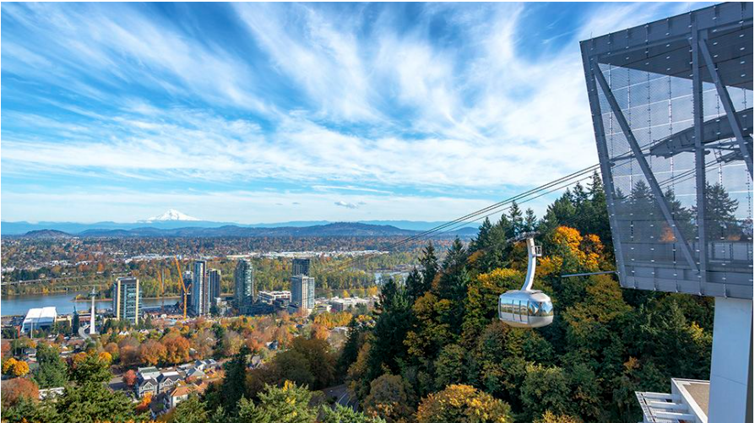
Emily (Yueng-hsiang) Huang,
Ph.D. Emily (Yueng-hsiang) Huang,
Ph.D.
Emily (Yueng-hsiang) Huang, Ph.D.
Ph.D. in Industrial-Organizational Psychology/Systems Science
Senior Research Scientist at Liberty Mutual Research Institute for Safety (2001-2017)
Adjunct Professor at NTU and NCCU (2017-2018)
Professor at OHSU (2019-present)
Published 100+ peer-reviewed journal articles, 6 book chapters, and more than 120 conference presentations/proceedings
Provided recommendations to numerous occupational safety and health practitioners

Slide 30
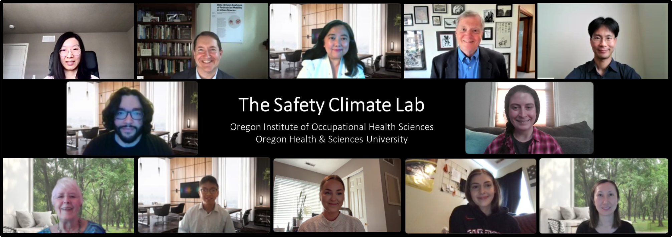
Safety Climate Lab
Principal Investigator: Emily Huang, Ph.D.
Project Managers: Frank Giordano, Ph.D. & Cassandra Chlevin, Ph.D. Candidate
Statistical Consultants: Yimin He, Ph.D. & Jin Lee, Ph.D.
Institute Mentor: Kent Anger, Ph.D.
Project Support: Jessie Zhen, MILR;
Kali Kuhn; Bailey Lytle, Ph.D. Student
Subject Matter Expert: Peg Rothwell
Research Consultant: Ted Courtney, MS, CSP
Intern: Nicholas Chiu
TWHC Intervention Project Manager: Courtney Donovan
Training Design Expert: Phoenix Rain Bird

Slide 31

Safety Climate
As a Leading Indicator of Workplace Safety

Slide 32
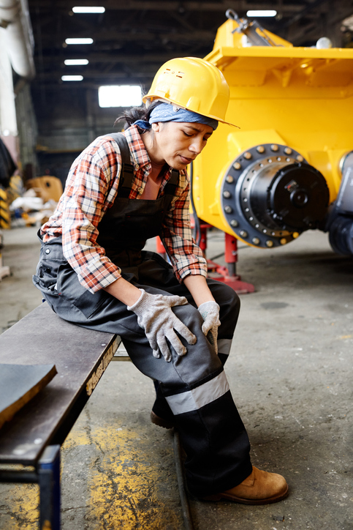
Occupational Injury
Continually a great workplace concern
In the 2022 U.S. private industry, there were:
2.8 million non-fatal workplace injuries & illnesses
2.3 cases per every 100 full-time equivalent workers
5,486 fatal workplace injuries
  (2023 U.S. Bureau of Labor Statistics)

Slide 33
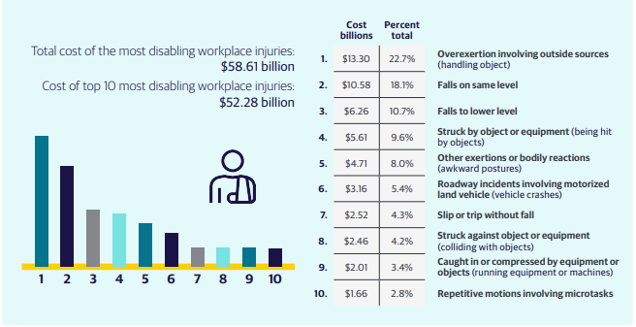
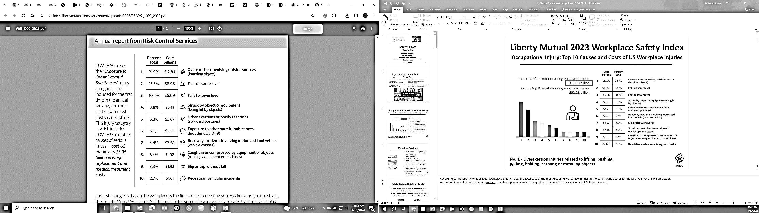
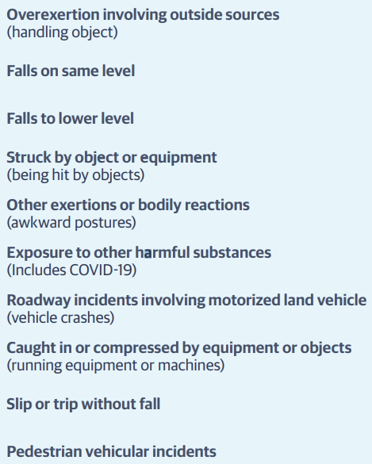
Top 10 Causes and Costs of U.S. Workplace Injuries
Liberty Mutual 2023 Workplace Safety Index
Total cost of the most disabling workplace injuries:
$58.61 billion
Cost of top 10 disabling workplace injuries:
$48.15 billion
Percent total
Cost billions
No. 1 - Overexertion injuries related to lifting, pushing, pulling, holding, carrying or throwing objects

Slide 34
Workplace Accidents
Bhopal
BP Deepwater Horizon
3 Mile Island
Tasco Refinery
Weak management of manning levels, workload, and shiftwork often due to downsizing
Inadequate training
Lack of communication
Poor safety culture, morale
Human-system interface deficiencies
Over/Under-reliance on automation
Information overload
Inadequate knowledge about system state in relation to safety boundaries
Safety Management Systems, metrics, oversight
Inadequate internal systems model

Slide 35


Safety Culture & Safety Climate
Safety Culture: Underlying beliefs and core values within an organization’s structures and control systems to produce behavior norms.
Underlying Beliefs
(How things work)
Core Values
(What’s important)
Behavior Norms
(How we do things here)
Safety Climate: A measurable aspect of Safety Culture

Slide 36


Definition of Safety Climate
First introduced by Dov Zohar (1980)
Safety Climate:
Employees’ perceptions of their company’s safety policies, procedures, and practices
Overall importance and “true” priority of safety at work
#1 Dimension: Managerial Commitment
Prioritize safety over delivery & other competing demands across a range of situations

Slide 37
Safety Climate is a Robust Predictor of Future Injury
+
Safety Climate
Safety Knowledge
+
_
+
Safety Performance
Accidents
& Injuries
+
+
Safety Motivation
Combined Results of 90 Studies
Meta-Analysis by Christian et al. (2009)

Slide 38
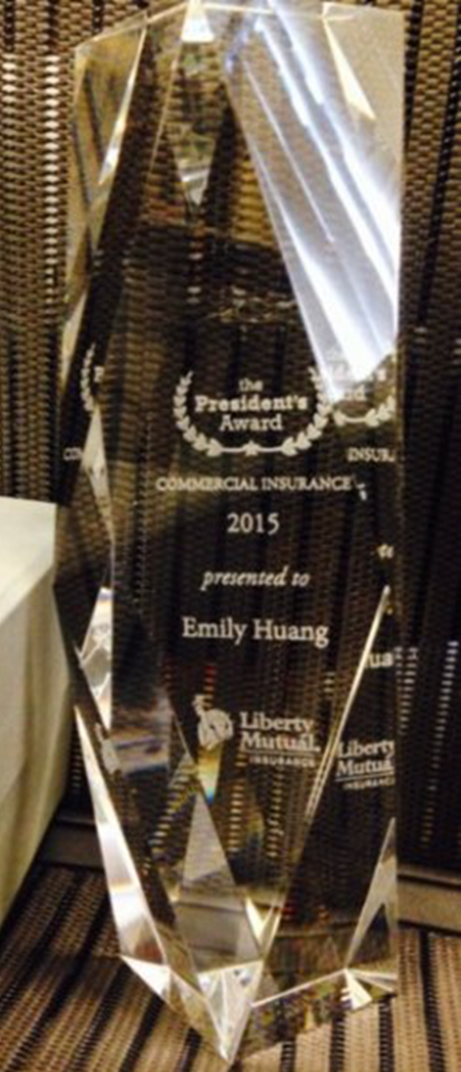
Research-to-Reality
Our Safety Climate surveys have been distributed to 50+ companies, reaching over 30,000+ participants within Liberty Mutual’s policy holders alone.

Slide 39
Employees’ vs. Supervisors’ Perceptions of Safety Climate
Study results showed:
Safety Climate scores of supervisors are higher than those of employees
Only employees’ safety climate perceptions are linked to safety outcomes
Safety Climate
Employee
.36**
-.31*
-.01
Safety Behavior
Lost Workdays
.03
Safety Climate
Supervisor
Huang et al. (2014), Traffic Psychology and Behavior

Slide 40
Impact of Safety Climate Beyond Safety Outcomes
Huang et al. (2016) showed that SC has significant impact on employees’:
Job Satisfaction
Employee Engagement
Objective Turnover Rate
The impact of safety climate extends beyond safety outcomes
+
Job Satisfaction
Safety Climate (company-level and group-level)
+
Employee Engagement
-
Objective Turn-over Rate
Huang et al. (2016), Applied Ergonomics

Slide 41
Safety Culture & Safety Climate
can be monitored and measured,
hence improved:
“What gets measured gets managed”

Slide 42


5 Main Projects
Safety Climate Survey
Total Worker Health Climate Survey (NIOSH)
Respectful Workplace Climate Survey (Oregon BOLI/DOT)
Building a Safe, Healthy, and Respectful Workplace for Tradeswomen (NIOSH)
Organizational Culture and Climate Intervention Training Program (NIH Fogarty)

Slide 43



Developing and Validating a
Respectful Workplace Climate Scale with Construction Workers as Exemplar:
A Total Worker Health® Approach

Slide 44
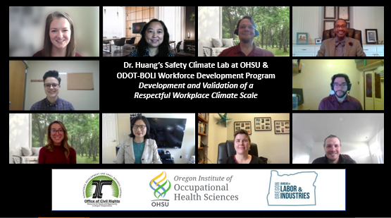

Slide 45

Purpose
Develop and validate a reliable Respectful Workplace Climate (RWC) Scale utilizing the well-established methods implemented by the Safety Climate Lab to develop our foundational Safety Climate Scales.

Slide 46

Respectful Workplace Climate Scale

Slide 47

Definition of Respectful Workplace Climate (RWC)
We conceptualized RWC as:
Employees’ perceptions of their company’s policies, procedures, and practices as they relate to building a respectful workplace
Overall importance and “true” priority of building a respectful workplace at work
#1 Dimension: Managerial Commitment
Prioritize RWC over delivery & other competing demands across a range of situations

Slide 48
Specific Aims
2. Demonstrate the reliability, construct validity, and criterion-related validity of the RWC scale with safety, health, and well-being outcomes
1. Develop a comprehensive Respectful Workplace Climate scale using our Safety Climate scale development research as a model
✔
Conduct literature review to develop initial items
✔
Demonstrate scale reliability
✔
Demonstrate various validities
✔
Utilize Subject Matter Experts to enhance the items
✔
Cross-validate the results
Conduct cognitive interviews and pre-test / feasibility test with workers to improve the scale
✔
Examine shared perceptions
✔
Develop practical shortened scale: Item Response Theory

Slide 49
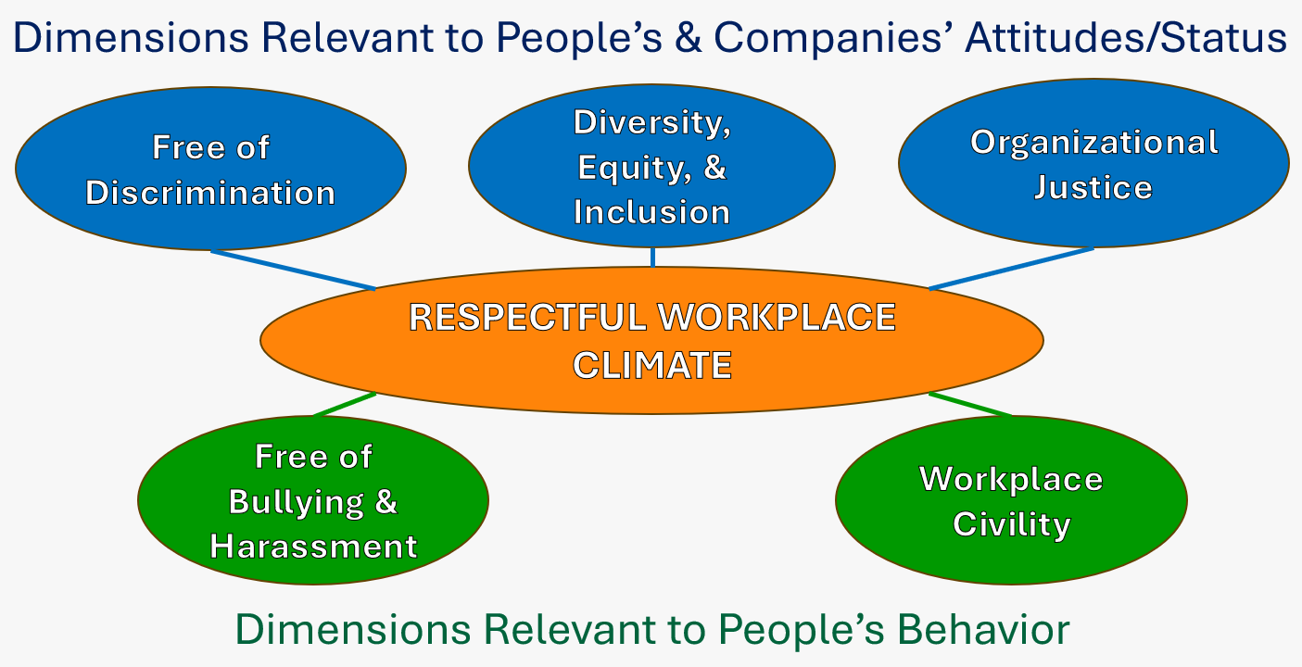
Key Dimensions

Slide 50





Key Findings from Literature Review
The Significance of Respectful Workplace
Better Health Conditions
for Employees
Better Mental Well-being for Employees
Less Interpersonal Conflict
Higher Level of Job Performance
Lower Turnover Rate

Slide 51
Potential Strategies for Building a
Respectful Workplace
Cob
Cob
Organizational Level
Supervisory Level
Coworker
Level
Individual
Level
Front-line workforce access to Employee Assistance Programs (EAPs)
Mental health and healthcare service access or information for employees through their benefits package
Workforce training and workshops on unconscious biases, mental health awareness, and communication competency
Diversity, equity, and inclusion efforts integrated in all organizational activities such as recruitment, selection, and promotional decision-making to ensure representation and inclusion at all levels
Holding themselves accountable for building a respectful work environment for their subordinates
Supporting and modeling respectful and healthy behaviors
Providing frequent feedback and conducting frequent check-ins
Discussing work-family balance behaviors
Recognizing and intervening with improper behaviors
Providing instrumental and emotional support
Demonstrating tolerance and inclusion
Fostering positive communication
Voicing concerns
Seeking help when needed
Connecting with local unions and trades-groups that provide support

Slide 52
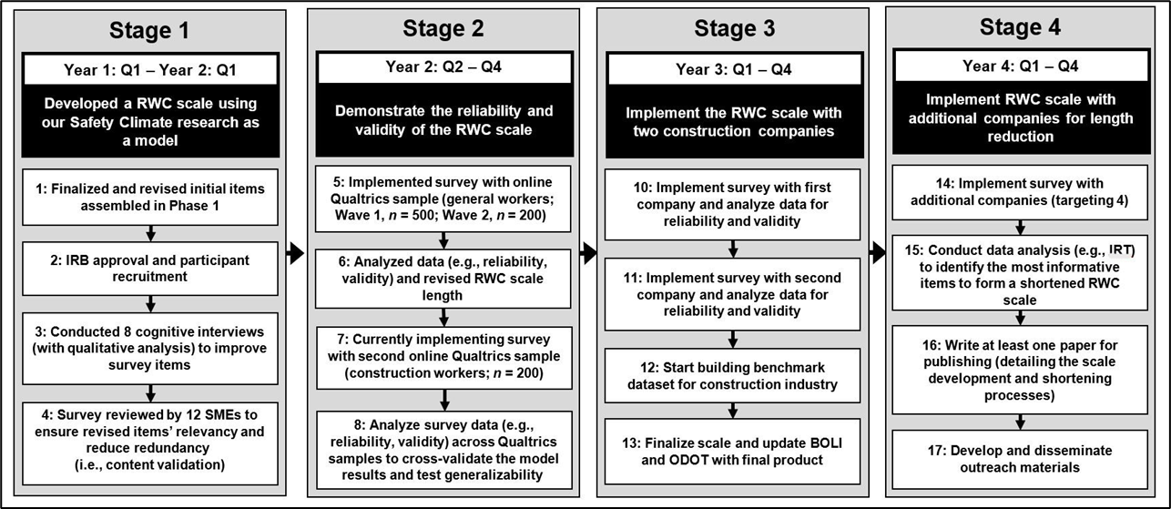
Process to Develop and Validate the Scale

Slide 53
Final RWC Scale Includes 3 Levels
Company-level (11 items)
e.g., My company applies fair procedures and practices.
Total of 35 items
Supervisor-level (16 items)
e.g., My direct supervisor gives assignments fairly, not based on favoritism.
Coworker-level (8 items)
e.g., My coworkers are able to respectfully express their opinions to others.

Slide 54
Outcome Scale (12 items)
At my company, I am treated with the same kindness and consideration as others.
At my company, I experience verbal harassment or bullying (e.g., cursed at, yelled at, called names, insulted/humiliated privately or publicly).
Our model also includes items about employees’…
Personal Experiences
How they are treated at work and whether they feel respected in their workplaces

Slide 55
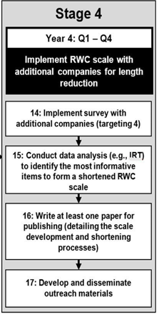
Final Stage
Assess outcomes in additional construction companies using the full RWC scale (35 items)
Develop a short RWC scale using Item Response Theory (IRT) with the combined dataset
Establish a benchmark dataset for construction firms for comparative purposes
Implement and validate the survey on construction jobsites
Share results through scientific papers, conferences, and outreach efforts

Slide 56
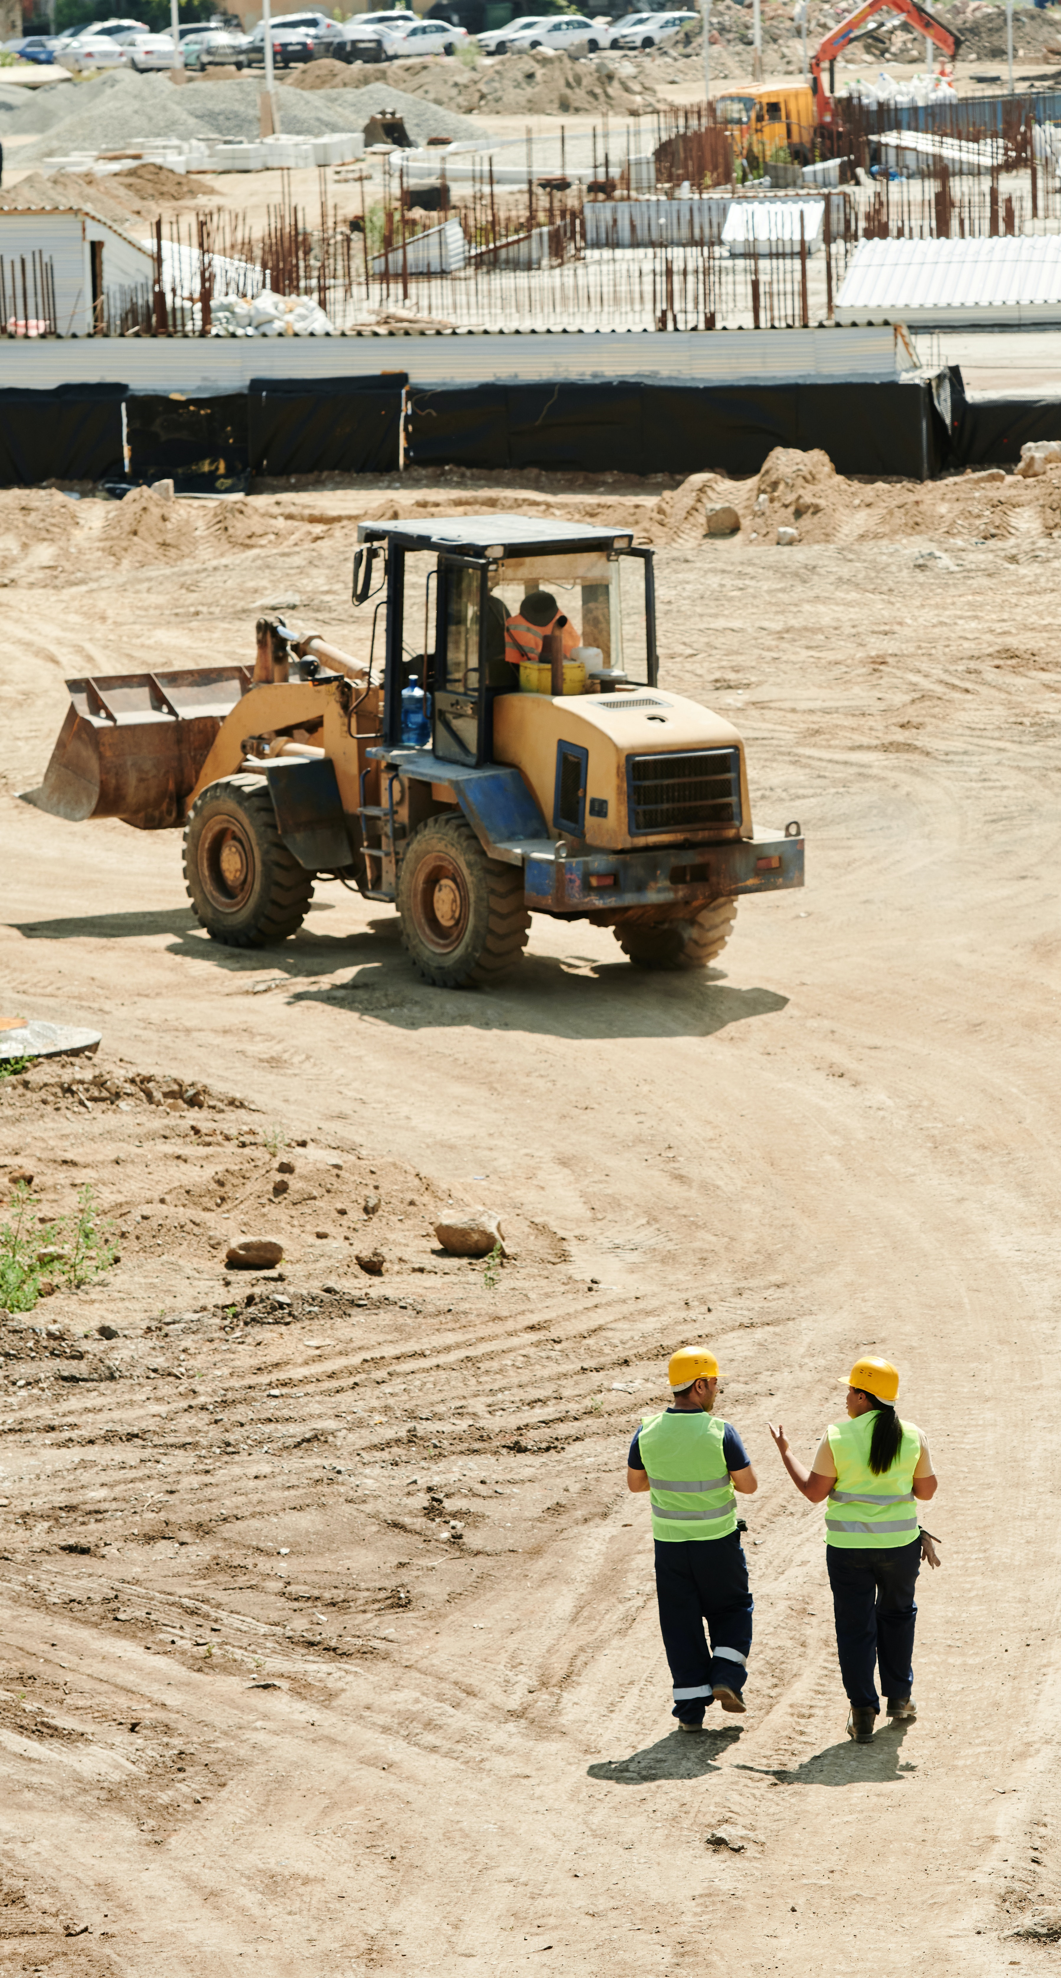
The Ultimate Goal
Evaluate the current status of an organization and help identify areas in need of improvement
Serve as a benchmark when comparing organizations, industries, or sectors
Serve as an internal yardstick to track organizational status/progress
Validate the effects of interventions aimed at building respectful workplaces

Slide 57
Building a Safe, Healthy, and Respectful Workplace for Tradeswomen:
A Total Worker Health® Approach

Slide 58
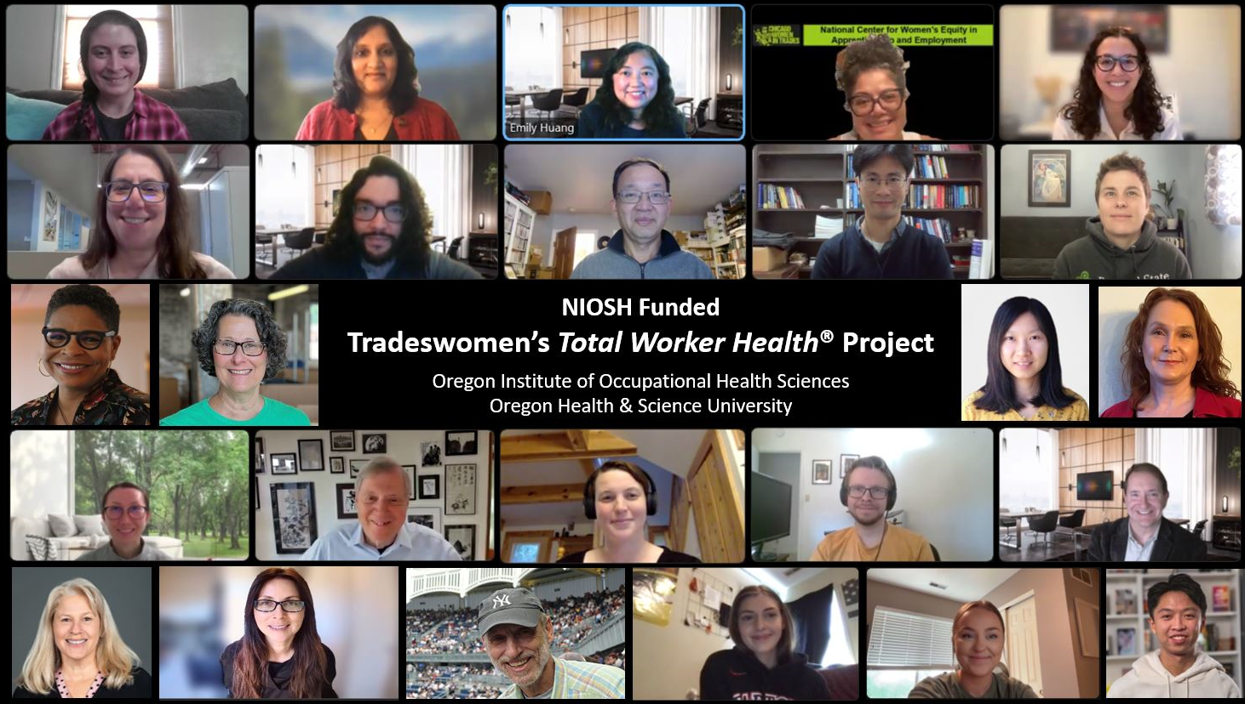

Slide 59

Objectives
Identify the unique workplace experiences tradeswomen face.
Quantify the impact these factors have on tradeswomen.
Identify workplace strategies that improve their safety, health, and well-being.

Slide 60


Current Steps
Quantitative Survey Implementation
Collect survey responses from 226 tradeswomen working in the construction industry across multiple companies.
Qualitative Focus Groups
Conduct focus groups with tradeswomen field experts to discuss the feasibility, benefits, barriers, and facilitators of individual- and organization-level strategies to address key stressors

Slide 61
Expected Outcomes
Research-to-Practice
Contributes to R2P by identifying the knowledge gaps regarding tradeswomen’s safety, health, and well-being outcomes, and developing and disseminating hands-on resources to mitigate those gaps.
Expected Outcomes
Survey and dissemination materials for tradeswomen and companies
Two peer-reviewed manuscripts
Outreach and dissemination will be through the Institute’s outreach unit, partner organizations, project panel of Tradeswomen Subject Matter Experts, and all participants.

Slide 62
5 Main Projects
Safety Climate Survey
Total Worker Health Climate Survey (NIOSH)
Respectful Workplace Climate Survey (Oregon BOLI/DOT)
Building a Safe, Healthy, and Respectful Workplace for Tradeswomen (NIOSH)
Organizational Culture and Climate Intervention Training Program (NIH Fogarty)

Slide 63
Thank you!
Emily Huang: huangyu@ohsu.edu
Erin Flynn: flynne@ohsu.edu
Visit us at:

